Slide 1
Composite (recursive descent parsing) and chain of responsibility

Slide 2
Topics
The composite pattern
Recursive descent parsing pattern/technique
The chain of responsibility pattern /technique
Why use it at all?
When should it be used?
The basic format
When and where

Slide 3
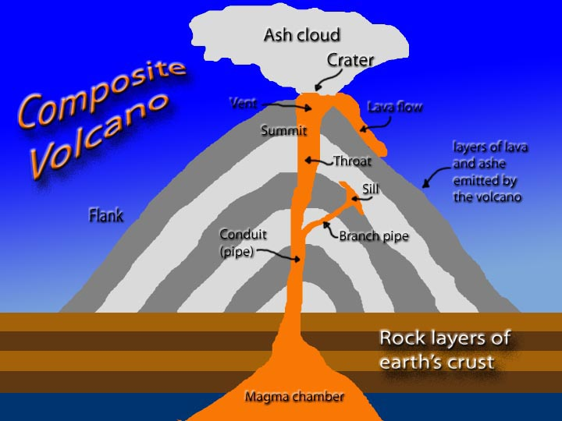

Composite
Pretty straight forward
One object is composed of smaller pieces
It is a subset of “has a” relationships in that this only applied to objects that are incomplete without their subparts, and the subparts disappear if the “root” object is deleted
Thus far this just seems like good decomposition

Slide 4
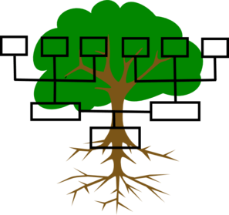
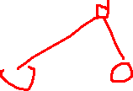
Composite
Main difference:
All subcomponents are derived from the same parent (or interface)!
Accessing the entire group object requires a technique called “recursive descent parsing”

Slide 5
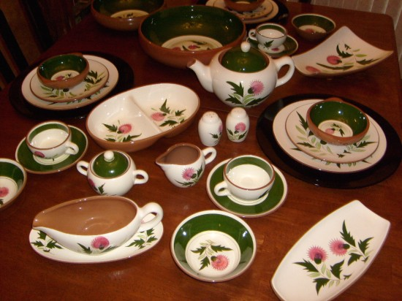
Example
Decomposition:
PlateSet
LargePlate
SmallPlate
TeaCup
Teapot
Pot
Lid

Slide 6
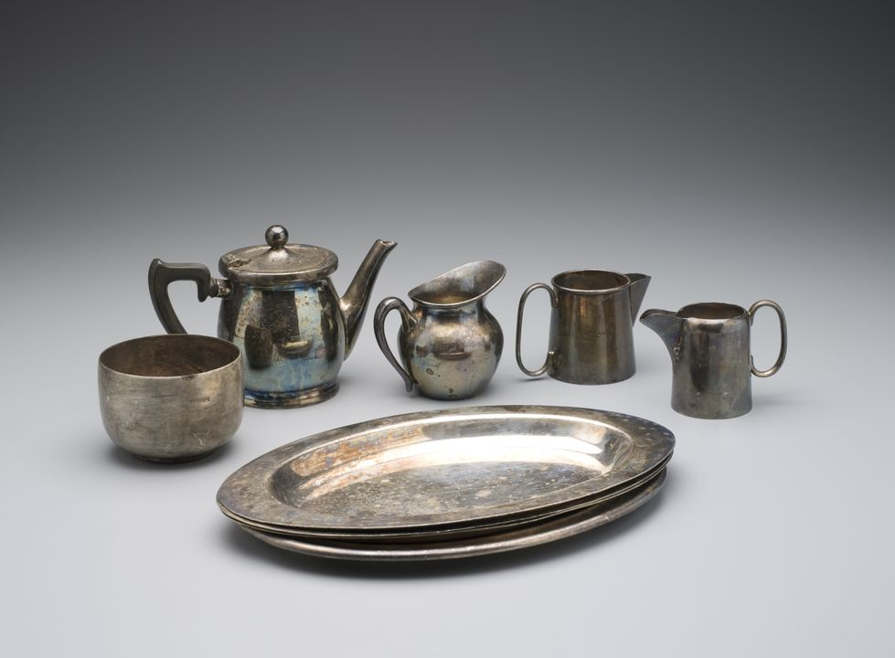
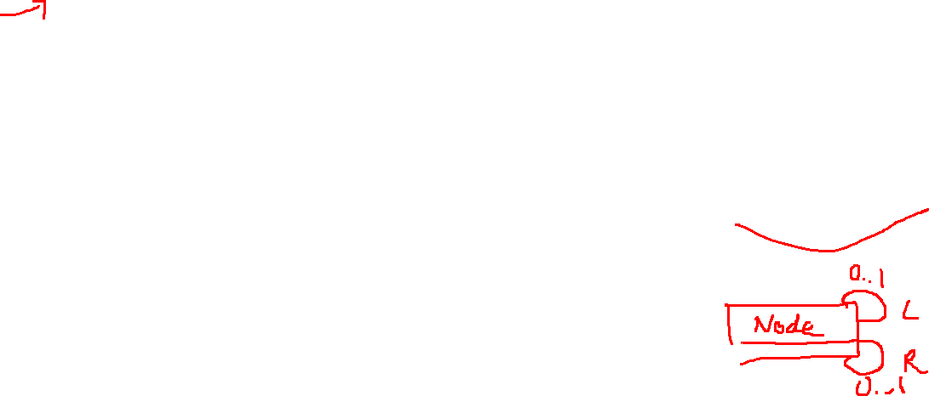
Example
Composite:
PlateSet (derived from Dishes)
LargePlate (derived from Dishes)
SmallPlate (derived from Dishes)
TeaCup (derived from Dishes)
Teapot (derived from Dishes)
Pot (derived from Dishes)
Lid (derived from Dishes)
* child
Dishes

Slide 7
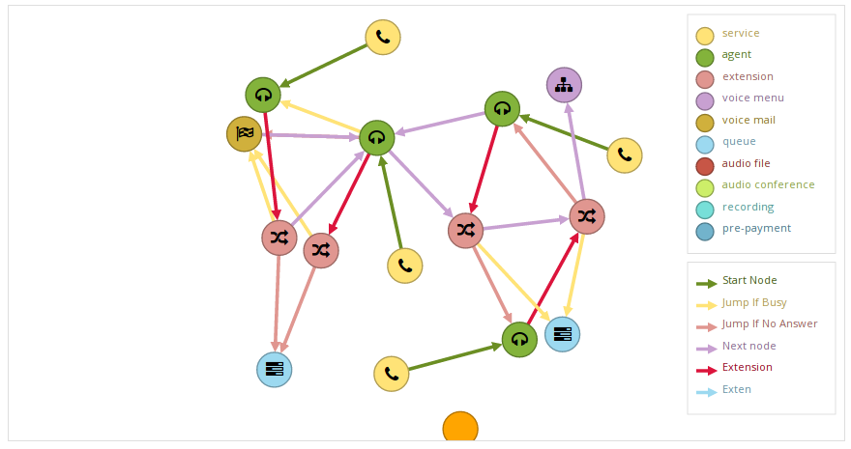

Why?
Regularly we naturally have something that owns another item of the same type
Graphs are notorious for this
Guarantees the same functions throughout
VERY common in simulators, graphics, monitors, models, animations, webdesign, etc

Slide 8
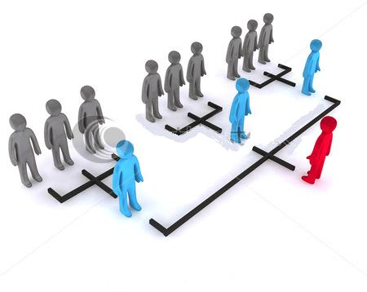

Recursive descent parser (RDP)
Recursive descent parser is the most common Composite “behavior”
It recursively forwards information to all components that may care about it
Really…
RDP is just a walkthrough of a generic tree. It just adds a task beyond "print" !
* child
<<interface>> Component
doThis() andChildrenToo()

Slide 9
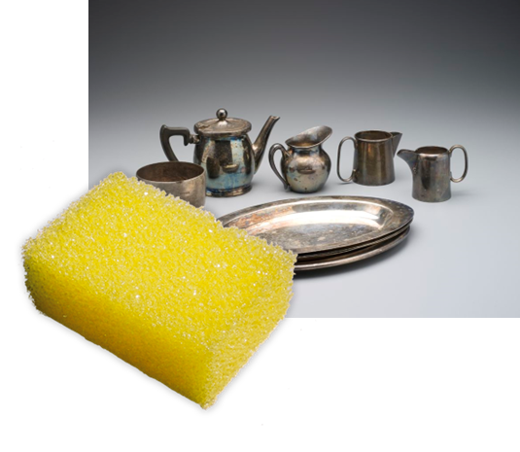
Example, with RDP
Let’s say we have our plate set
We want to clean them all
Check LargePlate (clean, move on)
Check SmallPlate (clean, move on)
Check TeaCup (clean, move on)
Check TeaPot (clean, forward call to subcomponents)
Check Pot (clean, move on)
Check Lid (clean, no more…stop)

Slide 10
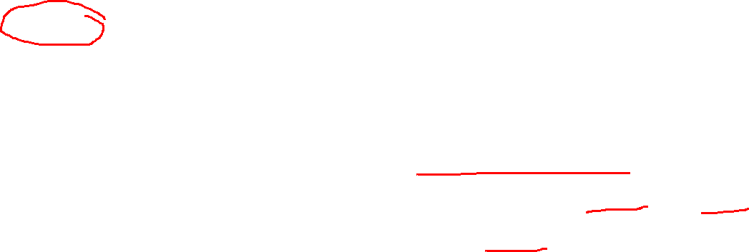
Example, with RDP
Other examples
XML
JSON
HTML loading
updateAll
moveAll
Brief aside: When is inheritance only OK?
RDP is specifically for treating an object with subcomponents as though it was a single massive class. If the tasks are solely for on one element rather than as a group, basic inheritance is fine.

Slide 11
Practice
A classical RDP example is parsing math
What is the decomposition to handle, +, -, *, /, and parenthesis to calculate an answer, ignoring order of operations?

Slide 12
Chain of responsibility (CoR)
Chain of responsibility is CLOSELY related to RDP
Its purpose to forward a command until someone handles it
Classical Format: linked list and stop when someone says they handled it
0..1 next
<<interface>> chain
doThis()

Slide 13
Chain of responsibility (CoR)
HOWEVER, the chain may instead be a tree which is quite common in GUIs!
It simply makes an early breaking search algorithm work on data with varying types
0..1 next
<<interface>> chain
doThis()

Slide 14
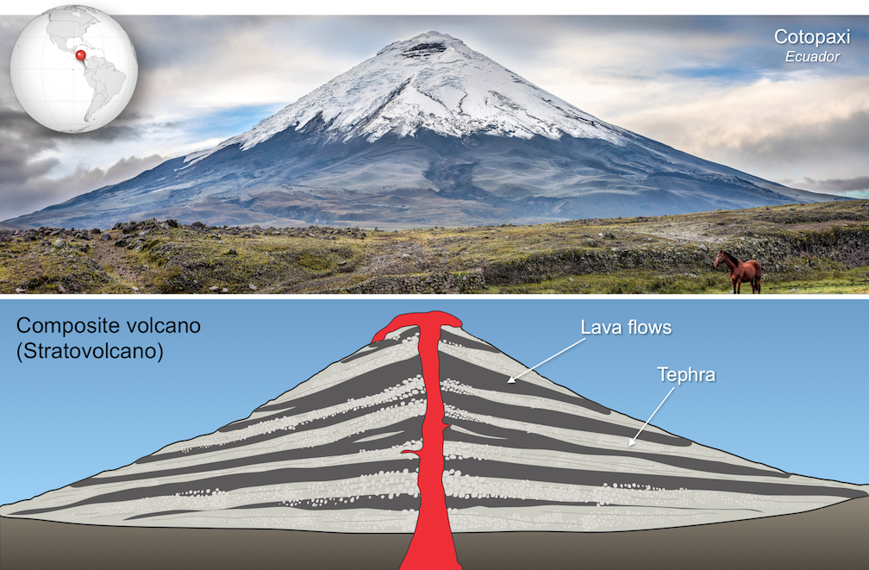
Composite place
BOTH RDP and CoR require the structural format of Composite to work properly!
The difference lies in how we “stop.”
RDP stops only after all subcompents are hit.
CoR stops early if a subcomponent marks the task as “handled”

Slide 15
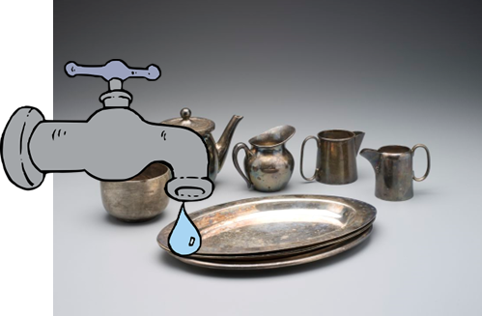
Example, CoR
Let’s say we have our plate set again
We want to find the first item that can hold 20 fluid ounces
Check LargePlate
no, move on
Check SmallPlate
no, move on
Check TeaCup
no, move on
Check TeaPot
Pot
yes, return back through the chain
Lid (not reached)

Slide 16
Example, CoR
Other examples
First internet connection option found
First exception handler that handles my current exception
First component that accepts the “k” key

Slide 17
Practice
A classical CoR example is exception handling
What is the class decomposition to find a file that could be on the local file system, USB, or internet, in that order?

Slide 18
When should these be used? (start)
Near requirements…
You have a “deeply” nested structure
“Deeply” means 3 or more
If there are a list of children, it is a near guarantee
A function at the top level also affects its subcomponents (or visa versa) (RDP)
OR
You are trying to find something to handle a task, and you don’t care who (CoR)

Slide 19
OPTIONAL
More details on format

Slide 20
Overview
Fundamentally, we have a root class, that has an associated link to itself. The needed functions are also placed in the root class.
Then, you derive your concreate classes, and make a “graph” out of them

Slide 21
Basic structure
I’ll start with the composite, since it form the structure needed for RDP and CoR
First, we need a root class!
That links to itself
Abstract OR interface
*
<<Composite>>

Slide 22
Basic structure
Second, we need to be able to add and remove components
*
<<Composite>>
addComponent(…) removeComponent(…)

Slide 23
Basic structure
Third, we make a concreate class
NOTE: this is the MINIMAL version
Now onto RDP and CoR
*
<<Composite>>
addComponent(…) removeComponent(…)
Component

Slide 24
Basic structure
Fourth, we add a function we use to travel down the collection
If it is “RDP”, there is normally NOT a return
*
<<Composite>>
addComponent(…) removeComponent(…) forwardInfo(…) : void
Component

Slide 25
Basic structure
If it is a “CoR” type, there is normally a return
Boolean is particularly common as it indicates “was handled”
*
<<Composite>>
addComponent(…) removeComponent(…) findFirst(…) : dataType
Component

Slide 26
Basic structure
These are MINIMAL solutions
CoR
RDP
*
*
<<Composite>>
addComponent(…) removeComponent(…) findFirst(…) : dataType
<<Composite>>
addComponent(…) removeComponent(…) forwardInfo(…) : void
Component
Component

Slide 27
Variations
A tree is of course, OK
0..1 right
0..1 left
<<Composite>>
addComponent(…) removeComponent(…) RDP/Cor funcs
Component

Slide 28
Variations
Composite, often has a special leaf node
This is mostly to guarantee there is no link to another composite component
Leaf
<<Composite>>
addComponent(…) removeComponent(…) RDP/Cor funcs
Component
1..*

Slide 29
Variations
Sometimes the chain allows transversals in both directions
* children
<<Composite>>
addComponent(…) removeComponent(…) RDP/Cor funcs
Component
0..1 parent

Slide 30
Basic structure
The current structure is good for uniformity, but…
* children
<<Composite>>
addComponent(…) removeComponent(…) RDP/Cor funcs
Component
0..1 parent

Slide 31
Basic structure
This is better for type safety
* children
<<Composite>>
RDP/Cor funcs
Component
addComponent(…) removeComponent(…)
0..1 parent

